Slide 1
Report on S-101 FC 1.0.0
S-101PT4 / KHOA Presented by KRISO (HyunSoo CHOI)
S-101 Electronic Navigational Chart Project Team

Slide 2
Introduction
S-101 FC 1.0.0 progress of KHOA
S-101 FC 0.9.1 based on S-101 DCEG(ver. July 2018) - TSM6, 2018
S-101 FC 0.9.2 based on S-101 DCEG(ver. November 2018) - S-100WG4, 2019
New S-101 FC 1.0.0 based on S-101 DCEG 1.0.0
S-101 FC 1.0.0 based on S-101 DCEG Official 1.0.0(ver. December 2018) - NOW
There should be a discussion about S-101 DCEG errors and discrepancies

Slide 3
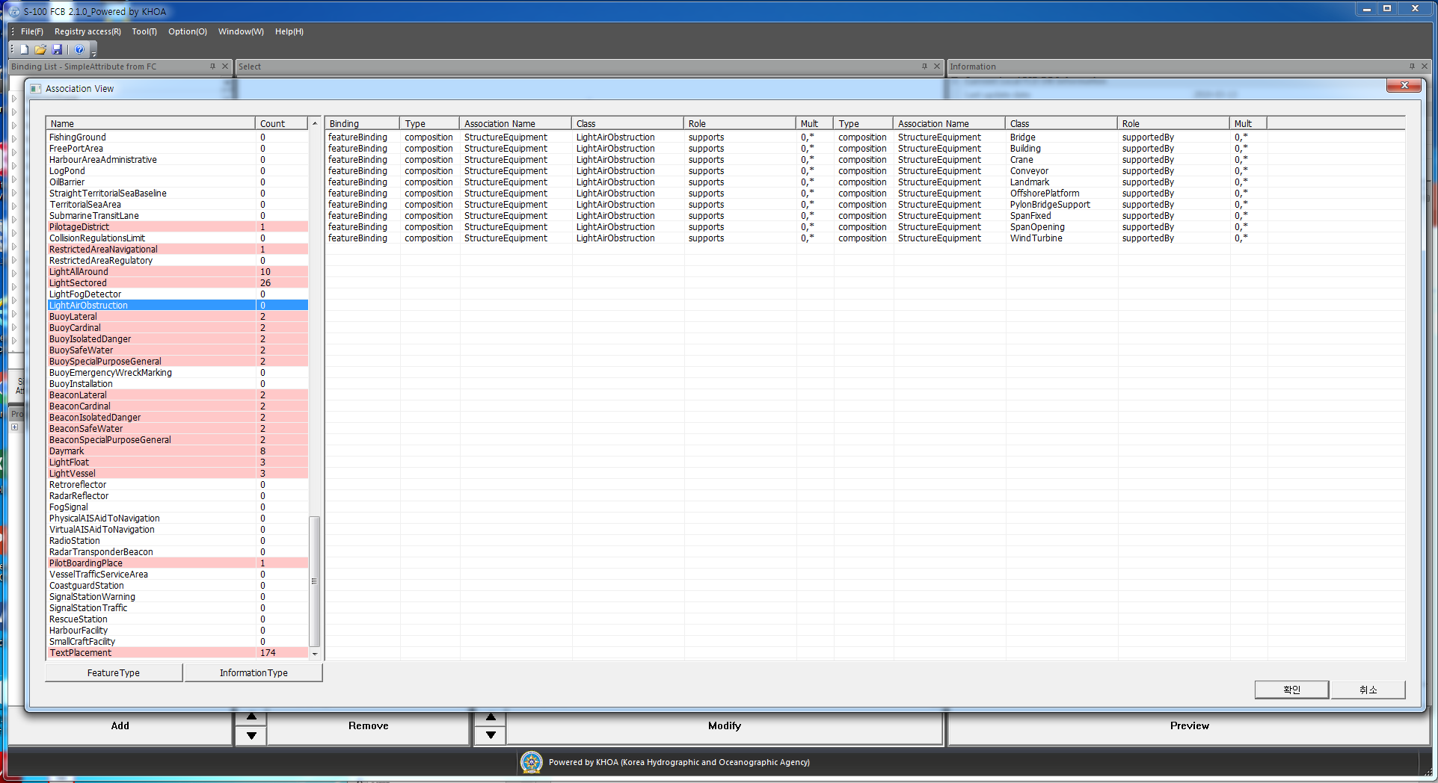
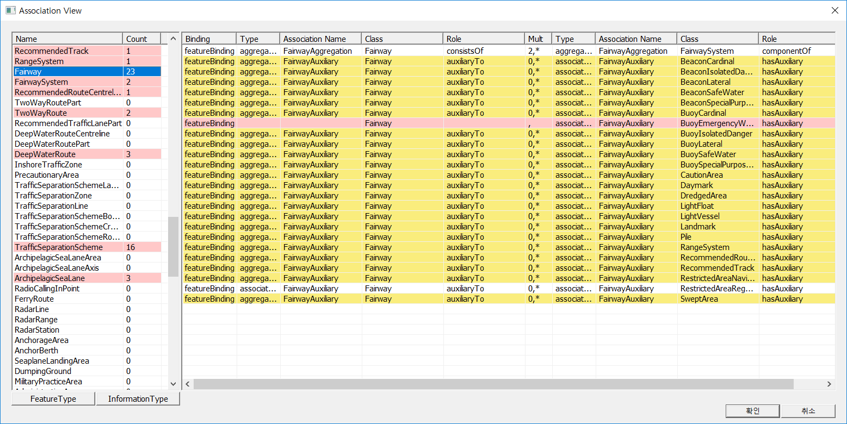
Updated information
KHOA released S-100 FCB 2.1.0
New function : Comparison tool for S-10X FC
After create S-10X FC following S-10X DCEG, users can validate FC files by themselves
It’s seem there are some errors and discrepancies between S-101 DCEG DOC and FC

Slide 4
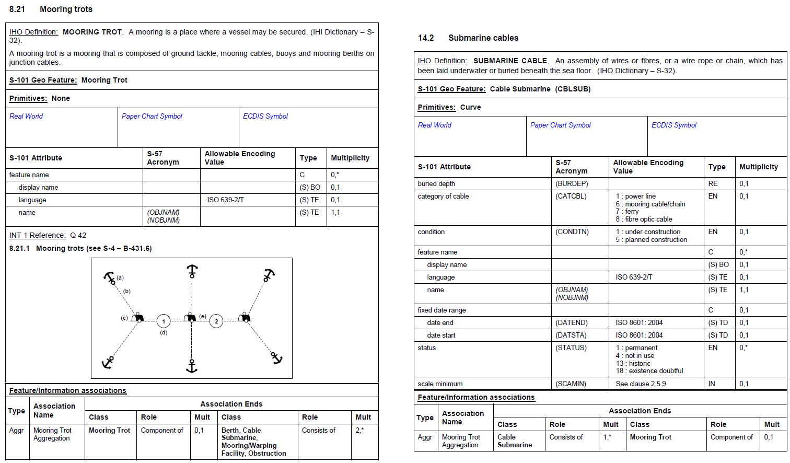
Which items are compared?

Slide 5
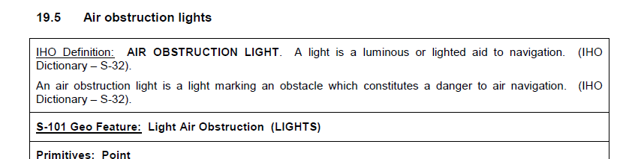
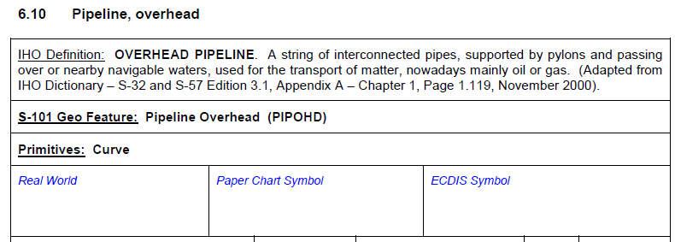
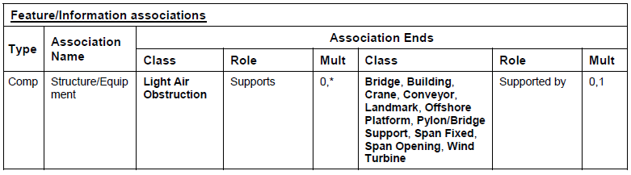
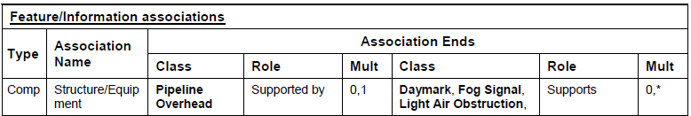
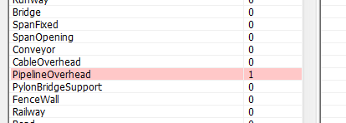

Discrepancy of association binding (omission)
???
For example at S-101 DCEG,
(right pic) Pipeline Overhead has Light Air Obstruction
(left pic) But Light Air Obstruction doesn’t have Pipeline Overhead

Slide 6
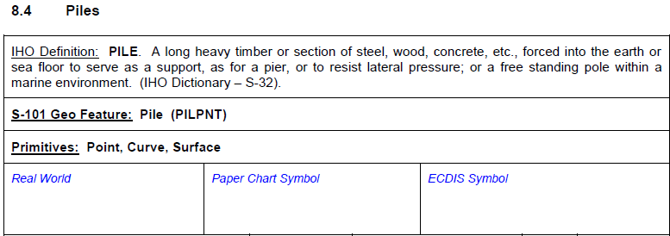
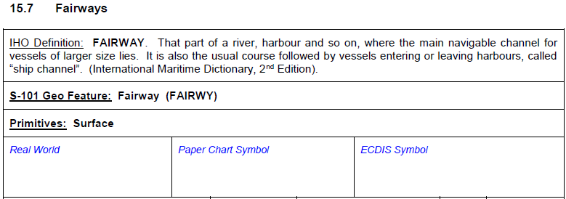
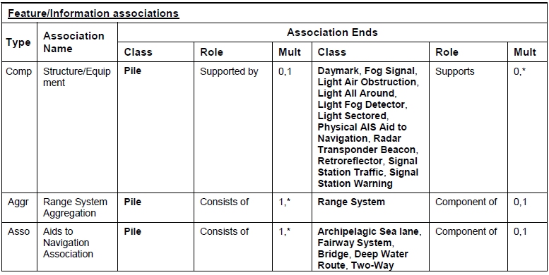
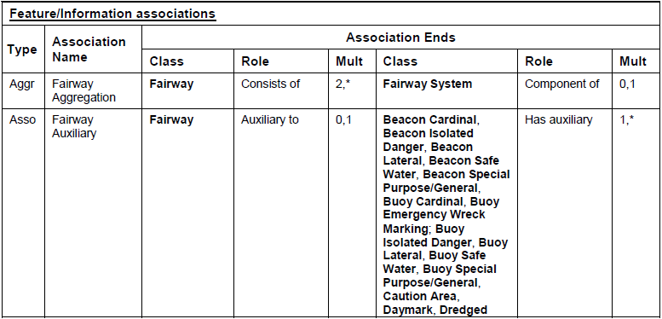

Discrepancy of association type or association name
Discrepancy of Association type
Piles has association as Aggregation
Fairways has association as Association

Slide 7
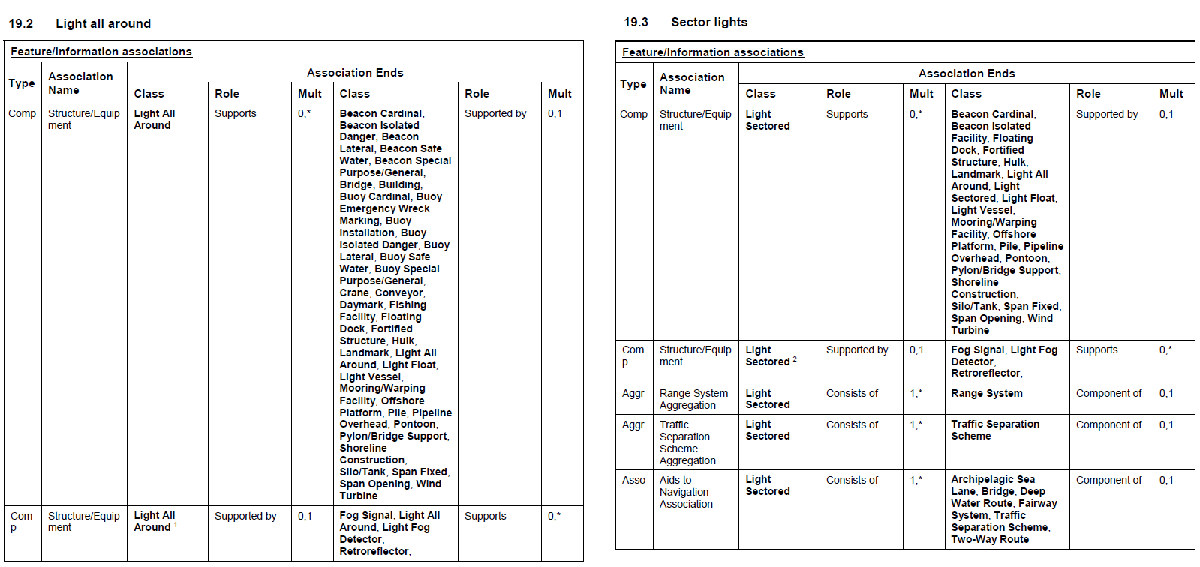
Discrepancy of Feature association
(Left side) Light all around shall be an equipment, so it bound for 2 times with supports and supported by roles
(Right side) Light sectored shall be an equipment, but it bound for only 1 time
???

Slide 8
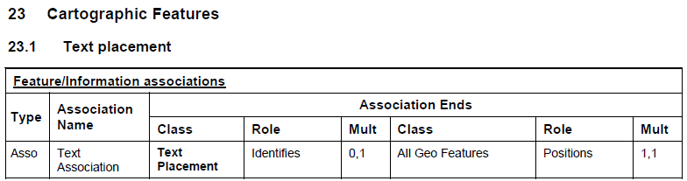
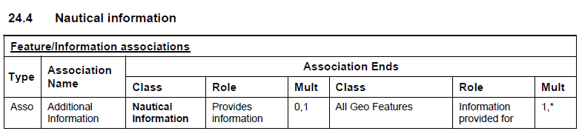
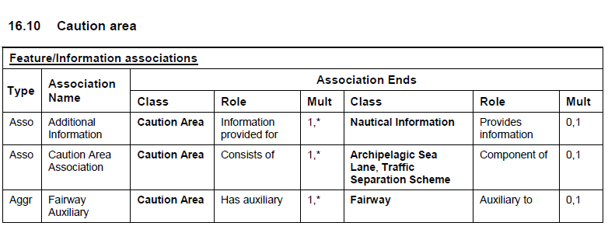
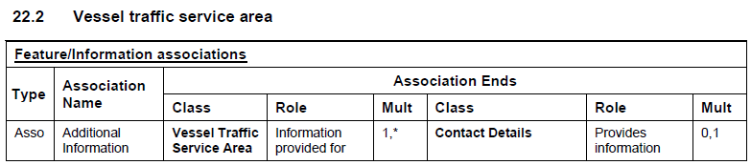
Binding issue for All Geo Features
(Left side) It is necessary to discuss whether to bind the text placement to All Geo Features or to bind only the features that has the text placement in the feature page
(Right side) Because the Nautical information also defined as All Geo Features, but only Caution area has Nautical information as an information type

Slide 9
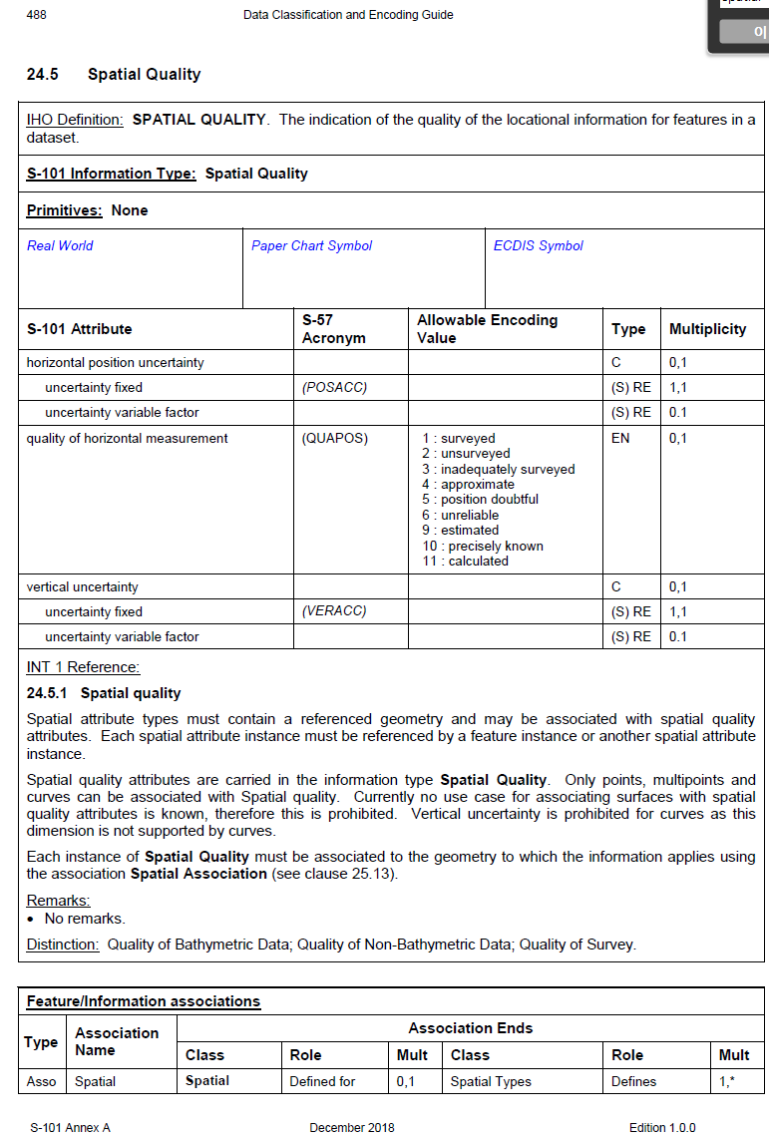
What is Spatial types?
In S-101 DCEG DOC, there is no clear definition which features are spatial types
It makes hard to developers when create S-101 FC, which features should be bound as spatial types

Slide 10
Conclusion
The S-101PT4 is invited to:
a. Note this paper
b. Discuss the S-101 FC issues reported by this paper
c. Request to update the S-101 FC accordingly

